Slide 1

PROPOSAL: LOW RISK AIRCRAFT SELECTION

Slide 2
PROPOSAL: LOW RISK AIRCRAFT SELECTION
PRESENTATION BY FIONA AMUGUNE

Slide 3
INTODUCTION
We analyze aviation accident data to identify trends and patterns that can help analyze Aviation Accident trends with the lowest-risk aircraft on behalf of a company looking to diversify its portfolio

Slide 4
OVERVIEW
This project aims to assist a company in diversifying its portfolio by purchasing and operating airplanes for commercial and private enterprises.
The primary goal is to determine which aircraft presents the lowest risk for the company as it embarks on this new business endeavor.
By analyzing aviation incident data, this project seeks to provide insights that will help guide decision-making on aircraft purchases.

Slide 5
Business Understanding
Aviation Safety Analysts: Focused on data-driven insights for risk assessment.
Regulatory Authorities: Aim to ensure compliance with safety standards and regulations.
Potential Customers: Concerned with the reliability and safety of the services provided.
Company Executives: Interested in minimizing risks associated with aircraft purchases.

Slide 6
Key Business Questions
Which aircraft models have the lowest associated risk based on historical incident data?
How do weather conditions impact the safety of different aircraft types?
What patterns can be identified in the engine types and their influence on injury severity?

Slide 7
Description of Data
The dataset includes various features such as:
Aircraft Model: The specific model of the aircraft involved.
Engine Type: The type of engine(s) used (e.g., single-engine, multi-engine).
Weather Conditions: Descriptions of weather at the time of the incident (e.g., VMC, IMC).

Slide 8
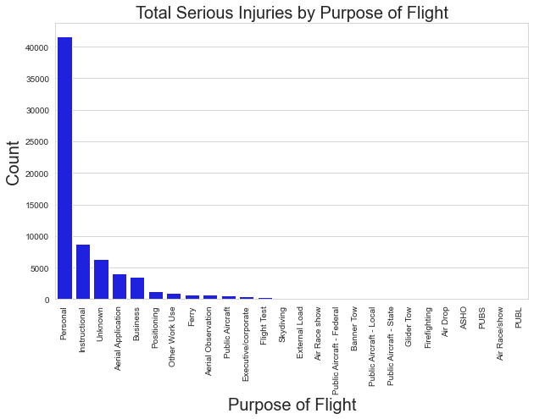

Slide 9
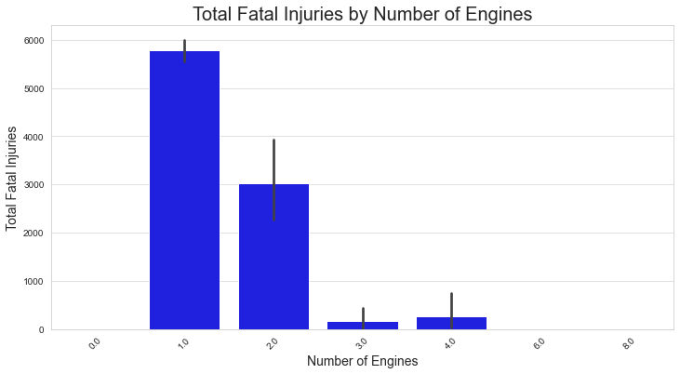

Slide 10
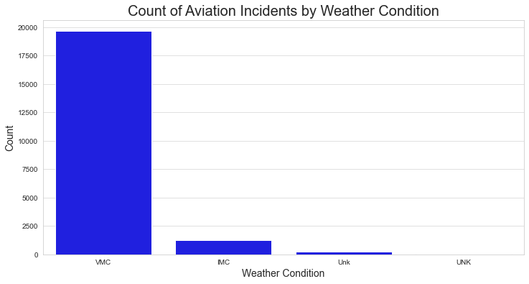

Slide 11

THANK YOU
Prepared by Fiona amugune

